Slide 1
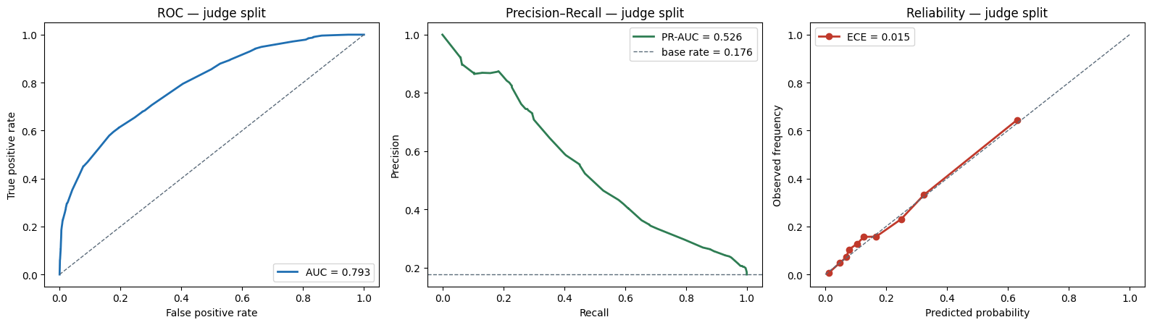
QUANTATHON V3 · SRNL & CLEMSON UNIVERSITY
EARTHQUAKE-Q
The Challenge — Read This First
A 24+-hour quantum–classical forecasting challenge
Challenge developed by Larry M. Deschaine, PhD
Quantum AI instructor: SRNL & Clemson University
September 25-27, 2026, Clemson, SC
Seismology
Machine Learning
Quantum
Honesty over hype
Notes:
Challenge-intro deck. Introduces the problem, data, scoring, clock, and rules — with no performance targets, so teams discover their own pathways.

Slide 2
THE MISSION
The Social Situation:
Forecast where the earth will move
Your task
The social challenge: Assuming an earthquake just occurred that significantly damaged buildings and other infrastructure. Develop a tool to predict whether and when aftershocks could occur within a typical damage zone ~100km), further destabilize it, and risk the health and safety of:
  Emergency response crews (30-day look-ahead) and
  Repair crews (6-month look-ahead)
The epicenter is being looked for. Specifically, when is it safe to allow rescue crews to enter the damage zone and begin life-saving operations with acceptable risk? When can infrastructure repair crews be mobilized?
You have just over 24 hours to build the best, most honest forecast you can and brief the stakeholders – emergency response crews are standing by….
It's open-ended
There is no single right answer. The pathway is yours to discover.
It's hands-on
You build everything from raw data and a starter notebook as a baseline — the craft is the point.
It's honest
Co-authoring a Journal Paper together
We reward forecasts you can defend, not the best number.
Winning prize
Challenge introduction
Earthquake-Q · QuantathonV3
2

Slide 3
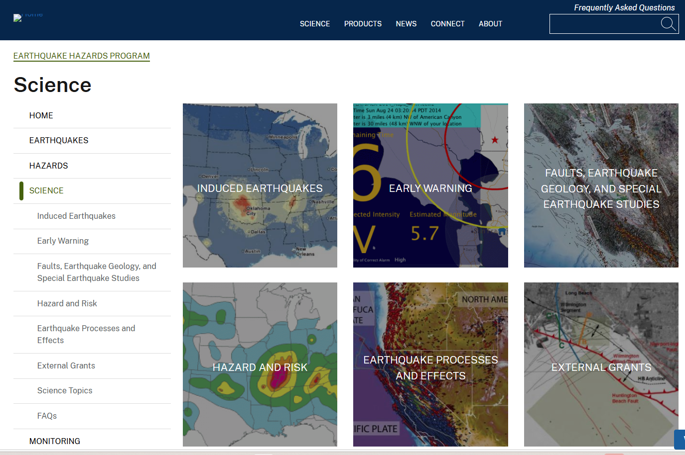
THE CHALLENGE DIFFICULTY
USGS Position on :
Can you predict earthquakes?
No. Neither the USGS nor any other scientists have ever predicted a major earthquake. We do not know how, and we do not expect to know how any time in the foreseeable future.
USGS scientists can only calculate the probability that a significant earthquake will occur ( shown on our hazard mapping) in a specific area within a certain number of years. An earthquake prediction must define 3 elements...

Slide 4
THE MISSION
What you are provided to start with:
Your task
You are given five raw geophysical data streams
A classical algorithm starter notebook that assembles the data and makes initial predictions
A 100-slide analysis of ideas and analyses others have tried; this will provide some background information to help you get started but should not be construed as the gold-plated analysis – or even fully correct without your verification.
Some questions to assess:
  Is there enough data?
  Is it the right data?
  Is it split right?
  Classical versus quantum versus hybrid approaches?
  Certainty versus uncertainty: when to allow rescue operations to commence? What is the safety margin, and how to present it to stakeholders.
It's open-ended
There is no single right answer. The pathway is yours to discover.
It's hands-on
You build everything from raw data and a starter notebook as a baseline — the craft is the point.
It's honest
We reward forecasts you can defend, not the best number.
Challenge introduction
Earthquake-Q · QuantathonV3
2

Slide 5
WHAT YOU PREDICT
One probability, a grid, a window
For each grid cell and each 30-day window: what is the probability that at least one magnitude ≥ 2.0 earthquake occurs within 100 km?
A probability
On a grid
In 30-day windows
A calibrated number in [0,1] — not a yes/no, not a magnitude, not a time.
Half-degree cells across the central & eastern United States.
Consecutive forward windows from a fixed information cutoff.
Because qualifying events are rare, this is a calibration problem, not a guessing game — more on scoring shortly.
Challenge introduction
Earthquake-Q · QuantathonV3
3

Slide 6
WHAT YOU GET
Five raw streams, three files
Seismic catalog
Every recorded earthquake: time, location, depth, magnitude. This is the signal.
THREE FILES, YOURS TO USE
train
Geomagnetic
Daily geomagnetic activity indices (ap, Kp) — a candidate driver.
1990 – 2021 · fit your models
test
Solar
Solar radio flux and sunspot number — candidate driver.
2022 – 2024 · tune & select
judge
Earth tides
Tidal potential and lunar phase — small periodic stresses.
2025 – 2026 · your honest self-check
You have all three. Use them wisely — and never let the future leak into the past.
GPS / GNSS
Daily station positions — crustal strain near fault zones.
Challenge introduction
Earthquake-Q · QuantathonV3
4

Slide 7
THE FORMAT
Long format: one row per observation
Every row has the same columns. Seismic rows carry the earthquake fields; the four driver streams carry a parameter and value.
source, time, latitude, longitude, depth_km, magnitude, station_id, parameter, value
seismic → time, latitude, longitude, depth_km, magnitude are populated
drivers → station_id, parameter, value are populated (e.g. parameter=ap, value=16.0)
We hand you a starter notebook
It reads the three files, builds a simple forecast, and reports honest accuracy statistics — fully offline.
It is deliberately plain. It is your common starting line, and there is a great deal you can improve.
Run it first. Understand it. Then make it better.
Review ideas in the 100-slide experimentation slide deck.
Challenge introduction
Earthquake-Q · QuantathonV3
5

Slide 8
HOW YOU'RE SCORED
Skill and honesty — not accuracy
Information gain
Calibration
Discrimination
How much your forecast beats the base rate, in bits per prediction. This is the primary metric — real skill, not guesswork.
When you say 20%, does it happen ~20% of the time? A confident-but-wrong forecast scores badly. Honesty is measured.
AUC and precision–recall — can you rank risky cells above safe ones? A useful check, but not the whole story.
How can the “risky” versus “safe cells inform the decision-makers?
Why not accuracy? Qualifying earthquakes are rare, so a model that always predicts “no” is highly accurate and completely useless. We score the information you add, and whether your probabilities are true.
Notes:
Scoring: information gain (primary), calibration, discrimination. No target numbers given — teams find their own level.

Slide 9
!
THE ONE RULE THAT MATTERS
Never let the future leak into the past
Every feature you build for a forecast must use only information available before that forecast's issue time.
Data leakage — letting an answer sneak into your inputs — is the single easiest way to fool yourself. The tell is simple:
if your judge-split score is far worse than your own test score, you have leaked.
The starter notebook is leakage-safe. Keep it that way as you add to it. Split by time, calibrate on held-out data, and always check your held-out number.
Can you develop a general-use map that can be posted on an emergency response website so response coordinators can, after an earthquake, click on an epicenter and instantly access the risk of significant aftershocks?
Train the way you will be scored: on a grid, at an issue time, looking only forward.
Notes:
The leakage rule is the single most important thing a team can internalize. Emphasize the test-vs-judge gap as the diagnostic.

Slide 10
YOUR PATHWAYS
Where you might take it — you decide
Better features
The other streams
Physics
Quantum
Richer seismicity: b-values, event-rate acceleration, multi-scale counts, recency. What does geography miss?
Geomagnetic, solar, tidal, GPS. Do they carry signal? Prove it from the data — don't assume it.
Aftershock-triggering models (like ETAS) are classic. Feeding physics into your model is a strong move.
Encodings, kernels, variational classifiers. If your track calls for it, explore where quantum can contribute.
No pathway is required, and none is guaranteed to win. The interesting result might be that a simple approach is hard to beat — if so, show us, with the numbers.
Challenge introduction
Earthquake-Q · QuantathonV3
8

Slide 11
DELIVERABLES
What to hand in
Your forecast
A probability for every scored cell-window, in the format the starter produces.
Your code
  The notebook or scripts that build your forecast, so we can see how you did it.
A short write-up
What you tried, what worked, what didn't, and — honestly — how well it did on your held-out check.
WHAT EARNS RESPECT
Skill with calibration — probabilities that are both informative and true.
A clean held-out story — your judge score is close to your test score (no leaks).
Clarity about uncertainty — you know what you know, and say so.
Honesty — if the simple approach won, you tell us, with evidence. If not, how the additional analysis techniques boost the ability to initiate rescue operations as soon as safe?
Challenge introduction
Earthquake-Q · QuantathonV3
10

Slide 12
Build something you can defend
You have raw data, a starting line, and 24+ hours.
There is no answer key to reverse-engineer — the pathway is yours to discover.
Make an honest forecast, know how good it is, and be ready to show your work.
Good luck.
EARTHQUAKE-Q · QUANTATHON V3 · CLEMSON UNIVERSITY
Notes:
Close: no answer key, discover your own pathway, be honest, show your work.

